Slide 1


Louis Wellmeyer
Aug 17th, 2025

Slide 2

Outline
Executive Summary
Introduction
Methodology
Results
Conclusion
Appendix

Slide 3
Executive Summary
Summary of methodologies
Data Collection
Data Wrangling
Exploratory Data Analysis
Interactive Visual Analytics
Predictive Analysis
Summary of all results
Exploratory Data Analysis (EDA)
Geospatial analytics
Interactive dashboard
Predictive analysis of classification models

Slide 4
Introduction
SpaceX lists the cost of Falcon 9 rocket launches on its website at 62 million dollars, while other providers charge over 165 million dollars per launch. Much of this cost difference comes from SpaceX’s ability to reuse the first stage. Thus, knowing whether the first stage will land successfully allows us to estimate the launch cost. This insight can be valuable for competitors looking to bid against SpaceX for a rocket launch.
Most unsuccessful landings are intentional. Occasionally, SpaceX opts for a controlled landing in the ocean.
The primary question we aim to address is, given various features of a Falcon 9 rocket launch - such as payload mass, orbit type, launch site, and other – can we identify the right circumstances for a successful launch and predict ongoing launch outcomes.

Slide 5

Section 1

Slide 6
Methodology
Executive Summary
Data collection methodology
Perform data wrangling
Perform exploratory data analysis (EDA) using visualization and SQL
Perform interactive visual analytics using Folium and Plotly Dash
Perform predictive analysis using classification models

Slide 7
Data Collection
There are various sources for useful data and distinct methods for collection, including but not limited to:
APIs
WebScraping

Slide 8
Data Collection – SpaceX API
The official SpaceX API provides information of past rocket launches including many interesting metadata
Refer for completed SpaceX API calls notebook https://github.com/Wellbek/IBM-Data-Science/blob/main/10%20Data%20Science%20Captstone/01/jupyter-labs-spacex-data-collection-api.ipynb

Slide 9
Data Collection - Scraping
Web Scraping is the technique of reading DOM-Tree data directly – therefore data can be gathered even when no specific interface is available.
Refer for completed web scraping notebook https://github.com/Wellbek/IBM-Data-Science/blob/main/10%20Data%20Science%20Captstone/01/jupyter-labs-webscraping.ipynb

Slide 10
Data Wrangling
After collection, data is available in raw format
Data wrangling is the process of
Cleaning and transforming data to ensure quality
Combining Data sources – e.g. API + Scraping
Preparing Data for Analysis – e.g. via Pandas dataframes

Slide 11
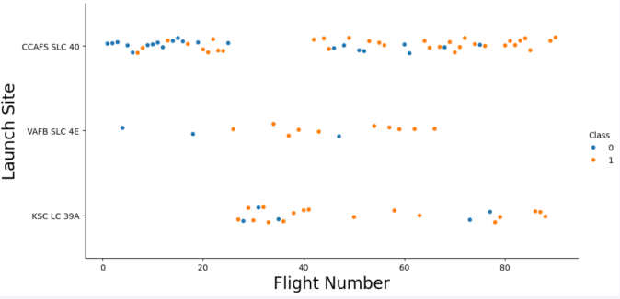
EDA with Data Visualization
To conduct first analysis, scatter plots, bar charts, line charts were used to visibly identify trends, links of variables, and identify outliers.

Slide 12
EDA with SQL
Following SQL queries were performed to gather information about the transformed rocket dataset:
Names of unique launch sites
Total payload mass carried by boosters (CRS)
Average payload mass by booster version F9 v1.1
Total number of successes and failures
Failed landing outcomes in drone ship and linked metadata

Slide 13
Build an Interactive Map with Folium
All launch sites were marked, and map elements like markers, circles, and lines were added to the folium map to indicate the success or failure of launches at each location.
Launch outcomes were categorized into classes, with failures assigned to 0 and successes to 1.
Launch sites with high success rates were highlighted using color-coded marker clusters.
Distances from each launch site to nearby points were calculated to determine optimal geopolitical positions.

Slide 14
Build a Dashboard with Plotly Dash
We developed an interactive dashboard using Plotly and Dash
Pie charts displaying the total launches for each site
Allows filtering by specific sites
Scatter plot illustrating the correlation between launch outcomes and payload mass across various booster versions
Includes a rangeslider to filter by payload mass ranges
Filterable by booster version

Slide 15
Predictive Analysis (Classification)
The data was loaded with numpy and pandas, then transformed and divided into training and testing sets.
Various machine learning models were developed, and hyperparameters were optimized using GridSearchCV.
Accuracy was selected as the evaluation metric, and the model was enhanced through feature engineering and algorithm tuning.
The top-performing classification model was identified.

Slide 16
Results
Exploratory data analysis results
Interactive analytics demo in screenshots
Predictive analysis results

Slide 17

Section 2

Slide 18
Flight Number vs. Launch Site
The scatter plot of Launch Site vs. Flight Number indicates that success rates improve with more flights.
Early flights (under 30) from CCAFS SLC 40 and VAFB SLC 4E were mostly unsuccessful
KSC LC 39A had no early flights and shows higher success.
After flight number 30, successful landings increase notably

Slide 19
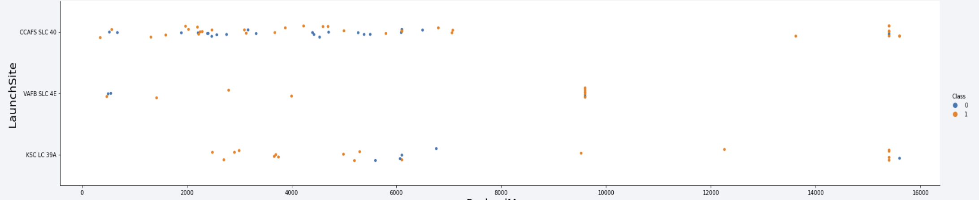
Payload vs. Launch Site
Payloads exceeding 9,000 kg generally achieve a high success rate;
Payloads above 12,000 kg appear to be feasible only at the CCAFS SLC 40 and KSC LC 39A launch facilities.

Slide 20
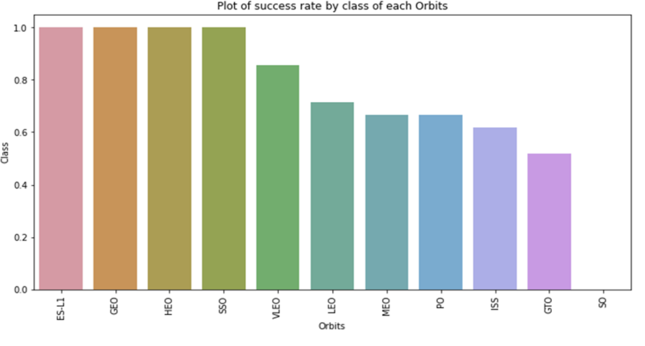
Success Rate vs. Orbit Type
following orbits have the highest (100%) success rate:
ES-L1
GEO
HEO
SSO
The orbit with the lowest (0%) success rate is:
SO

Slide 21
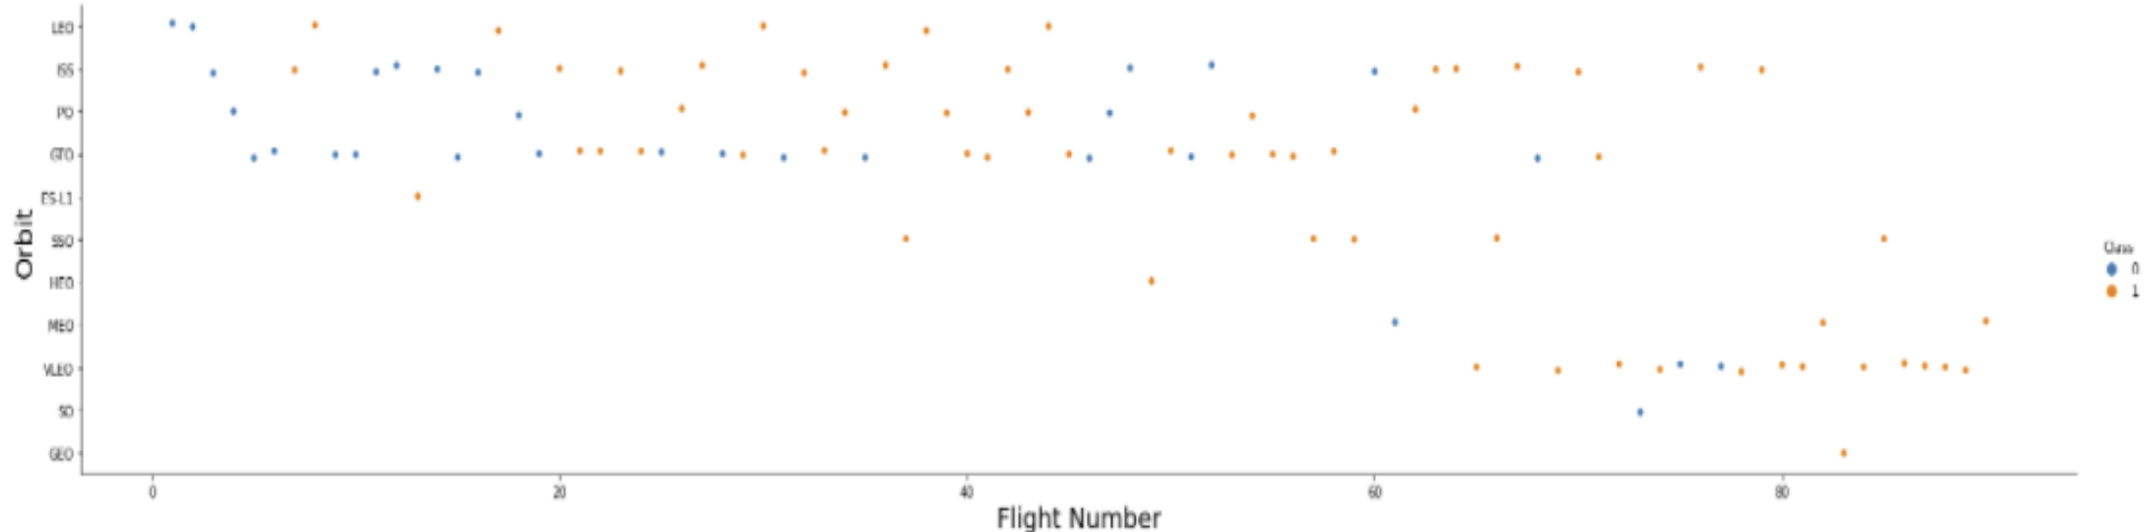
Flight Number vs. Orbit Type
Success in LEO correlates with flight number
in GTO, no such relationship exists.

Slide 22
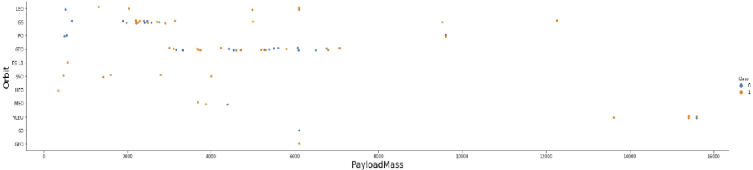
Payload vs. Orbit Type
Successful landings with heavy payloads occur more frequently in PO, LEO, and ISS orbits.

Slide 23
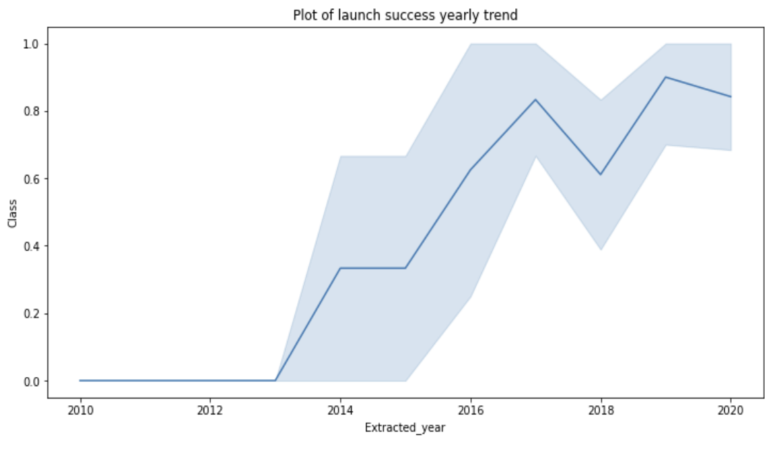
Launch Success Yearly Trend
Between 2010 and 2013, there were no successful landings, resulting in a 0% success rate.
After 2013, success rates increased overall, with slight declines observed in 2018 and 2020.
From 2016 onward, the probability of success has remained above 50%.

Slide 24
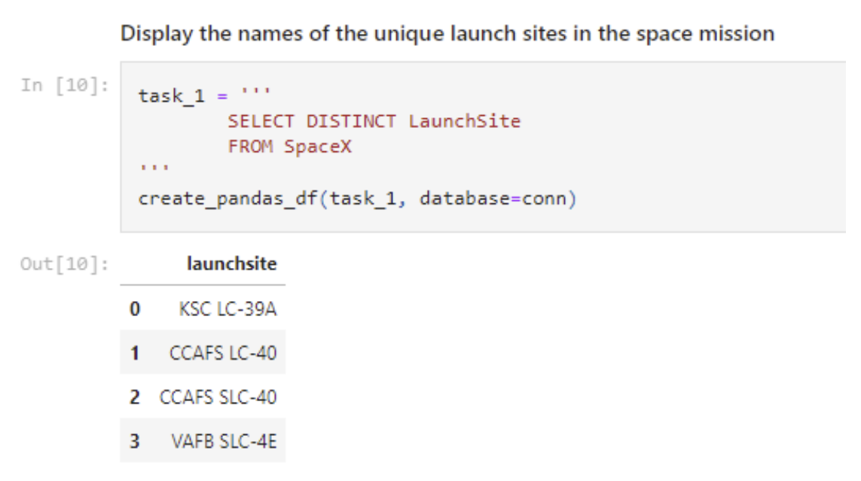
All Launch Site Names
Find the names of the unique launch sites
The word DISTINCT returns only unique values from the LaunchSite column of the SPACEX table

Slide 25
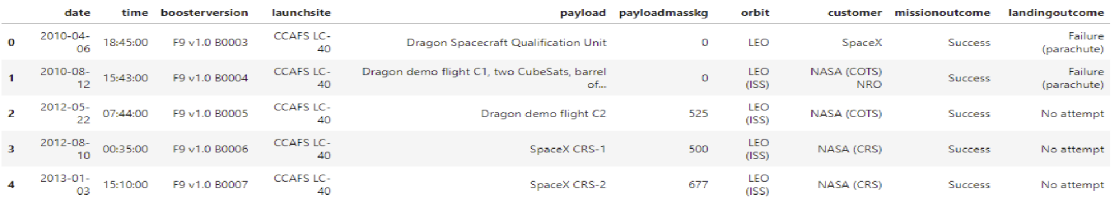
Launch Site Names Begin with 'CCA'
Find 5 records where launch sites begin with `CCA`
With LIMIT 5 only 5 records are fetched
The LIKE keyword was used with the wild card ‘CCA%’ to retrieve string values beginning with ‘CCA’.

Slide 26
Total Payload Mass
Calculate the total payload from NASA boosters
The total payload from NASA boosters is 45,596
This was found by summing the LAUNCH column for NASA boosters (CRS) only

Slide 27
Average Payload Mass by F9 v1.1
Calculate the average payload mass carried by booster version F9 v1.1
The average payload mass from booster version F9 v1.1 is 2,928.4
This was found by using the AVG keyword on the PAYLOAD_MASS_KG_ column for F9 v1.1 boosters only

Slide 28
First Successful Ground Landing Date
Identify the date of the first successful ground pad landing.
The initial successful ground pad landing occurred on December 22, 2015.
The MIN keyword was used on the DATE column, while the WHERE clause filtered for successful ground pad landings only.

Slide 29
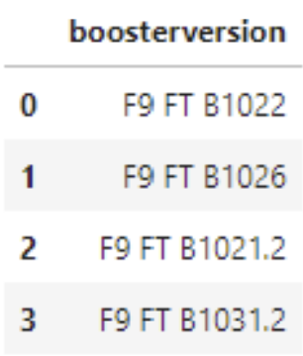
Successful Drone Ship Landing with Payload between 4000 and 6000
Provide the names of boosters that have successfully landed on a drone ship and carried a payload mass greater than 4000 but less than 6000.
The WHERE clause filters results to include only those meeting both conditions within the parentheses (with the AND keyword applied). The BETWEEN keyword selects values where 4000 < x < 6000.

Slide 30
Total Number of Successful and Failure Mission Outcomes
Determine the overall count of both successful and failed mission outcomes.
The COUNT keyword was used to tally the total mission outcomes, while a GROUPBY was applied to categorize these results based on the outcome type
mission_outcome | total_number
Failure (in flight) | 1
Success | 99
Success (payload status unclear) | 1

Slide 31
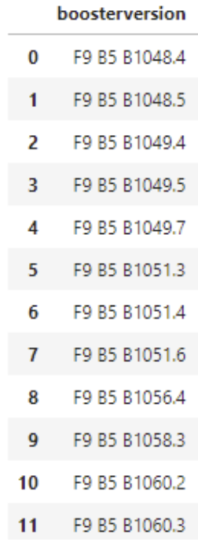
Boosters Carried Maximum Payload
Identify the names of the boosters that have transported the heaviest payload mass.
A subquery was used to determine the maximum payload, which is then applied in the original WHERE of the master query.
DISTINCT keyword ensures that only unique booster versions are returned.

Slide 32
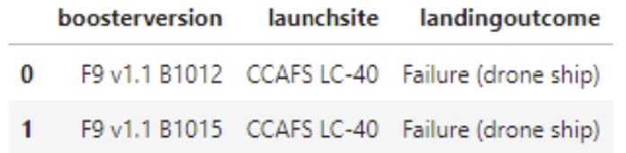
2015 Launch Records
Identify the failed landing outcomes on drone ships, including their booster versions and launch site names, for the year 2015.
A combination of WHERE clauses along with LIKE, AND, and BETWEEN conditions was used to filter failed landing outcomes on drone ships, their respective booster versions, and launch site names specifically for 2015.

Slide 33
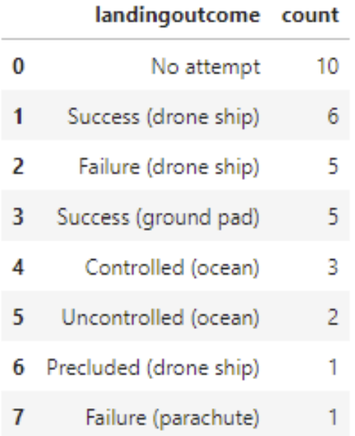
Rank Landing Outcomes Between 2010-06-04 and 2017-03-20
Rank the count of landing outcomes (such as Failure (drone ship) or Success (ground pad)) between the date 2010-06-04 and 2017-03-20, in descending order
A WHERE clause combined with BETWEEN filters the data to included only dates within the specified range. The results were then grouped using GROUP BY and sorted with ORDER BY, with DESC indicating descending order.

Slide 34

Section 3

Slide 35
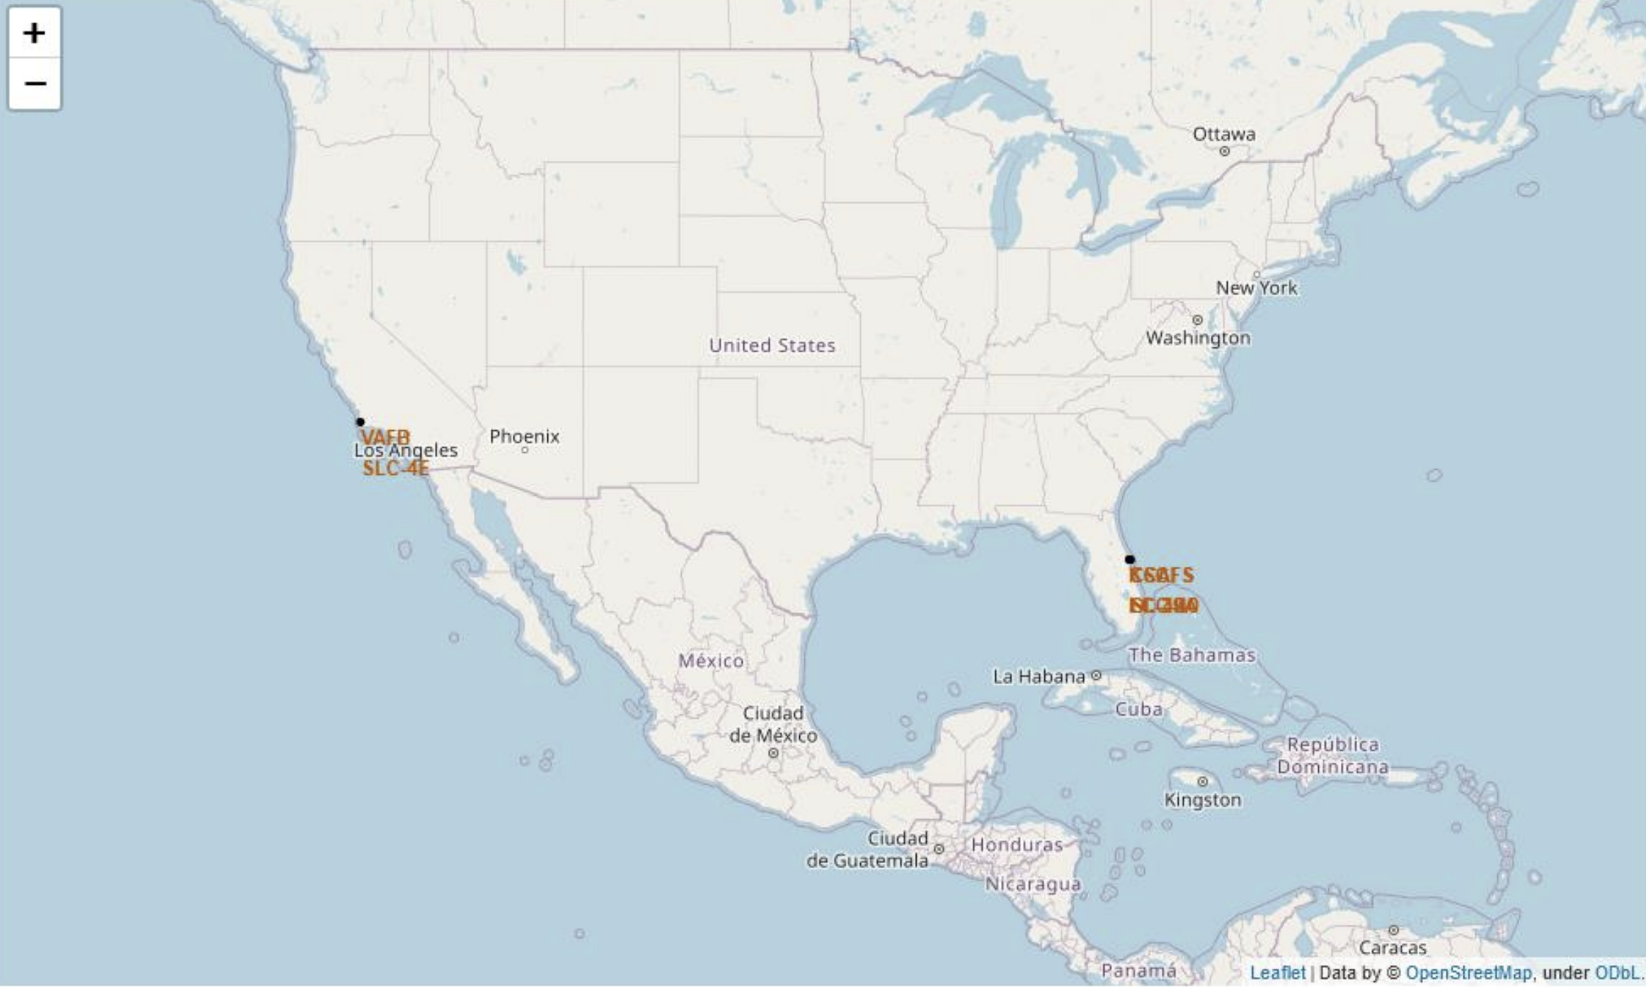
Launch Site Map
All SpaceX launch sites are on the coasts of USA
Florida
California

Slide 36
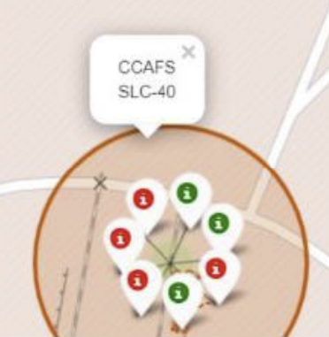
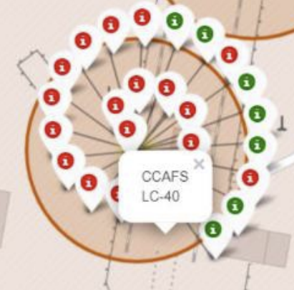
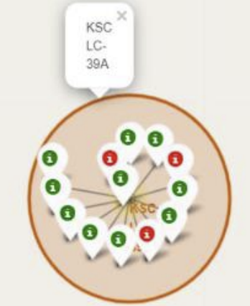
Launch Site Successes & Failures
launches were grouped into clusters to display successful and failed landings at launch sites
Green representing success
Red representing failure

Slide 37
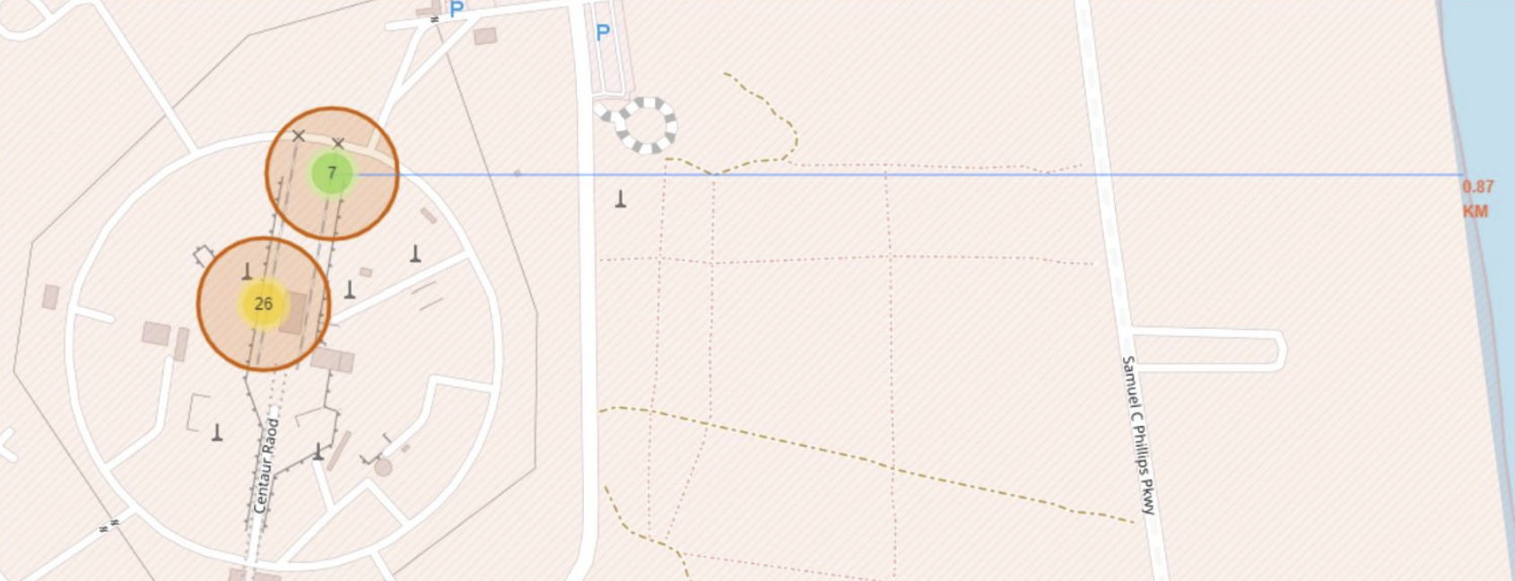
Launch Site Proximities
By examining the CCAFS SLC-40 launch site as a case study, we can gain a better understanding of how launch sites are positioned
Are launch sites in close proximity to railways? No
Are launch sites in close proximity to highways? No
Are launch sites in close proximity to coast lines? Yes
Do launch sites keep certain distance away from cities? Yes

Slide 38

Section 4

Slide 39
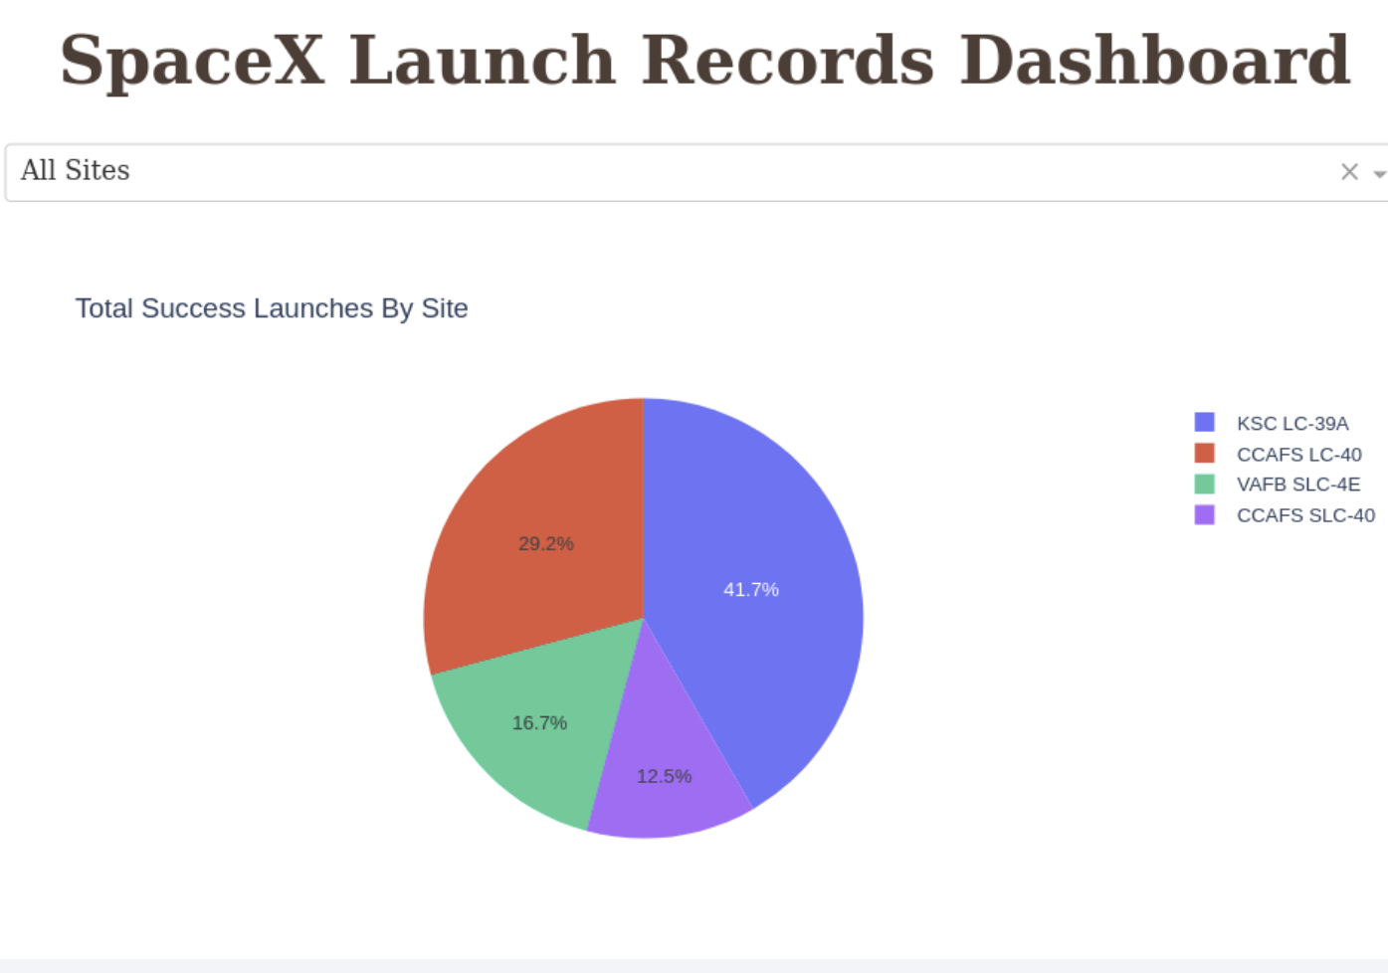
Successful Launches by Site
KSC LC-39A had the most successful launches from all sites

Slide 40
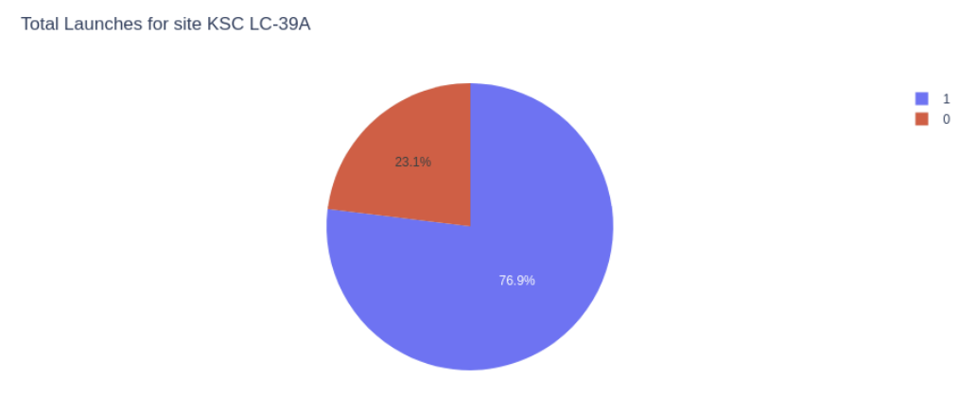
KSC LC-39A Success Rates
76.9% of launches are successful in KSC LC-39A

Slide 41
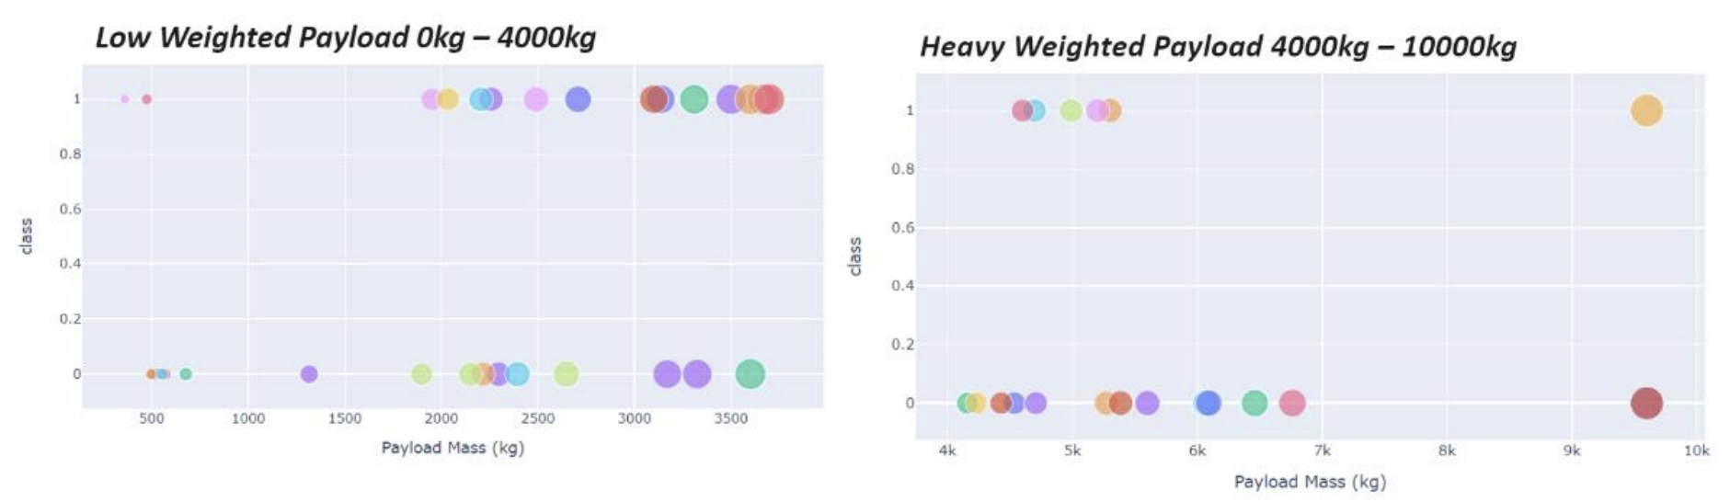
Payload vs. Launch Outcome
Success rates for low weighted payloads are higher than for heavy ones

Slide 42

Section 5

Slide 43
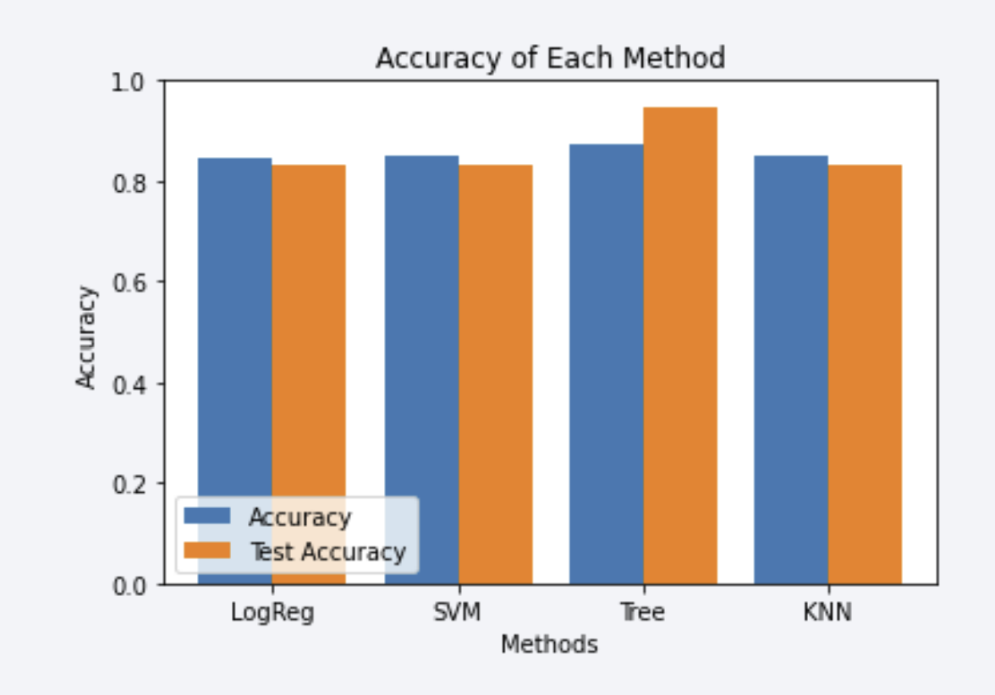
Classification Accuracy
Four different classification models were evaluated, and their accuracy results were displayed in a plot
Among them, the Decision Tree Classifier achieved the highest accuracy, surpassing 87%

Slide 44
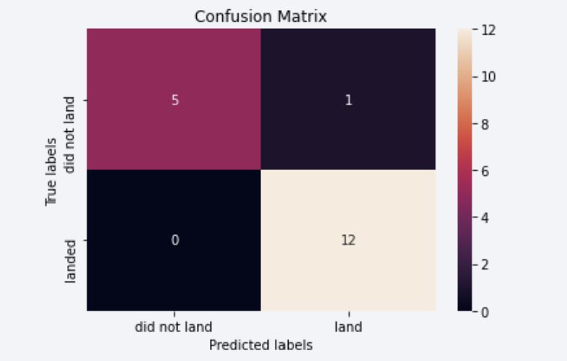
Confusion Matrix
CM of Decision Tree Classifier demonstrates its accuracy by displaying a significantly higher count of true positives and true negatives compared to false positives and false negatives

Slide 45
Conclusions
Higher flight volumes at a launch site are associated with increased success rates.
Launch success rates showed an upward trend from 2013 to 2020.
Orbits such as ES-L1, GEO, HEO, SSO, and VLEO demonstrated the highest success rates.
KSC LC-39A recorded the greatest number of successful launches among all sites.
The Decision Tree classifier proved to be the most effective machine learning algorithm for this task.

Slide 46
Appendix
Include any relevant assets like Python code snippets, SQL queries, charts, Notebook outputs, or data sets that you may have created during this project

Slide 47


